Slide 1
MUSIC RECOMMENDATION SYSTEM
Submitted by:
Aditya Rajendra Narnaware
Manibhushan Kumar
Dheeraj Kumar
Under the Guidance of:
Mr. Deepak Painuli
Assistant professor

Slide 2
INTRODUCTION
With the rise of digital content distribution, we have access to a huge music collection. With millions of songs to choose from, we sometimes feel overwhelmed. Thus, an efficient music recommender system is necessary in the interest of both music service providers and customers
Our music recommender system is large-scale and personalized. We learn from users’ listening history and features of songs and predict songs that a user would like to listen to.

Slide 3
WHY A RECOMMENDER SYSTEM?
Music dataset is too big while life is short!!!! You need someone to teach you how to manage and give you wise suggestions according to your taste!
Music service providers need a more efficient system to attraction their clients

Slide 4
Background and Motivation
Music Recommendations - excellent feature for any music application.
Better Recommendations - Better Conversions, More engagement
Develop a music recommendation system based on the Million Song Dataset using various recommendation methodologies and draw a comparative analysis between them

Slide 5
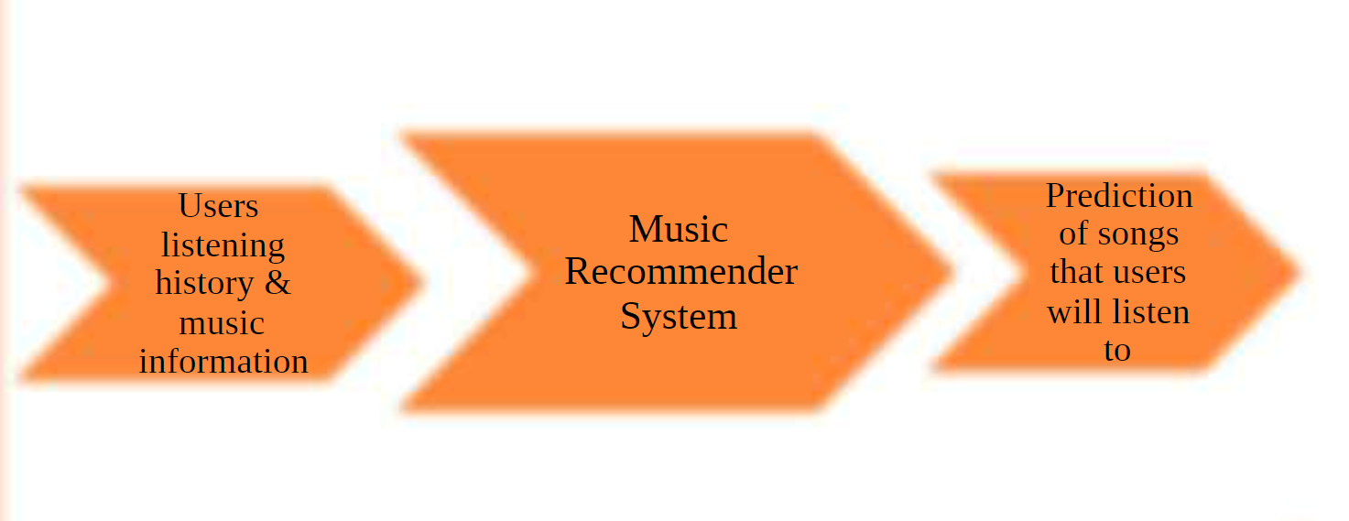
OUR TASK

Slide 6
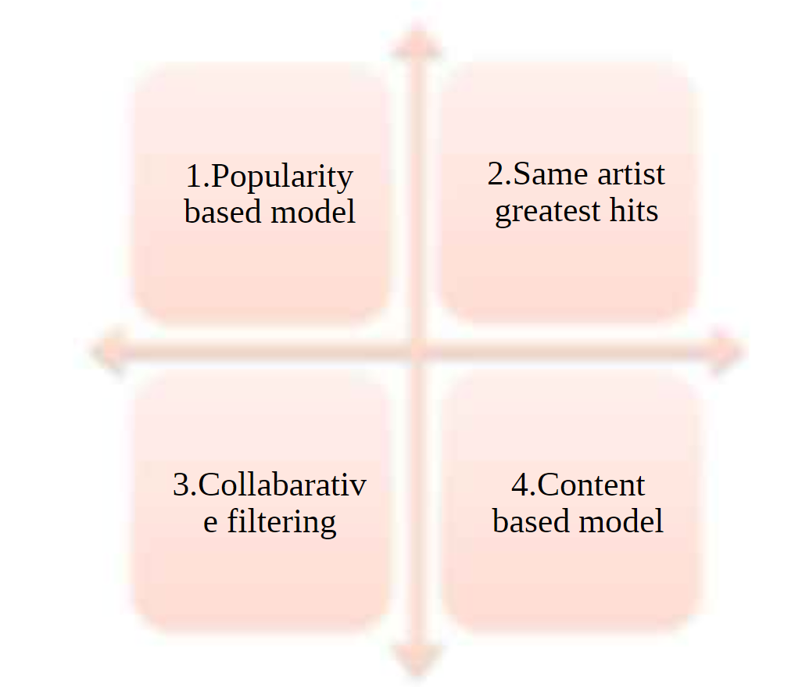
FOUR IDEAS

Slide 7
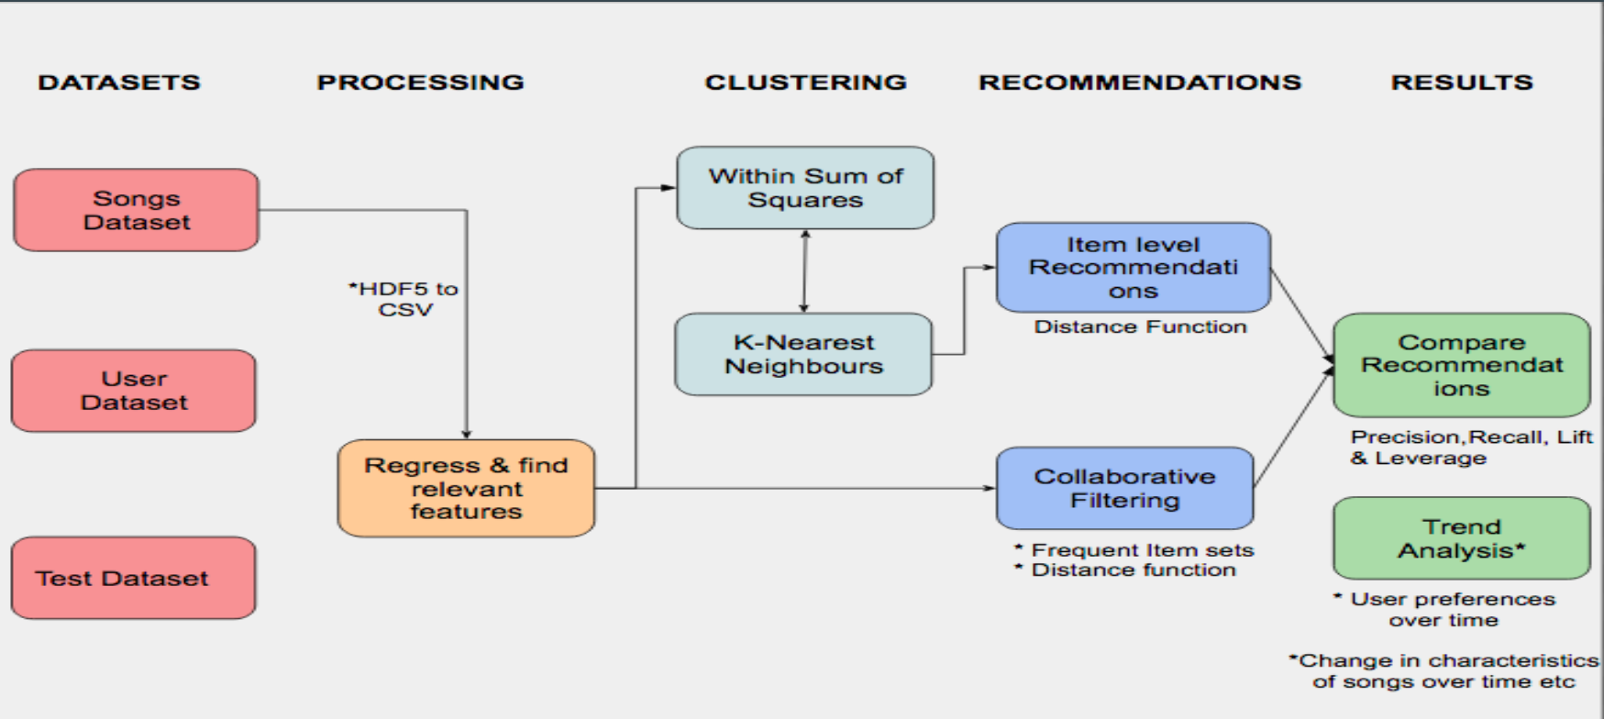
Project Pipeline

Slide 8
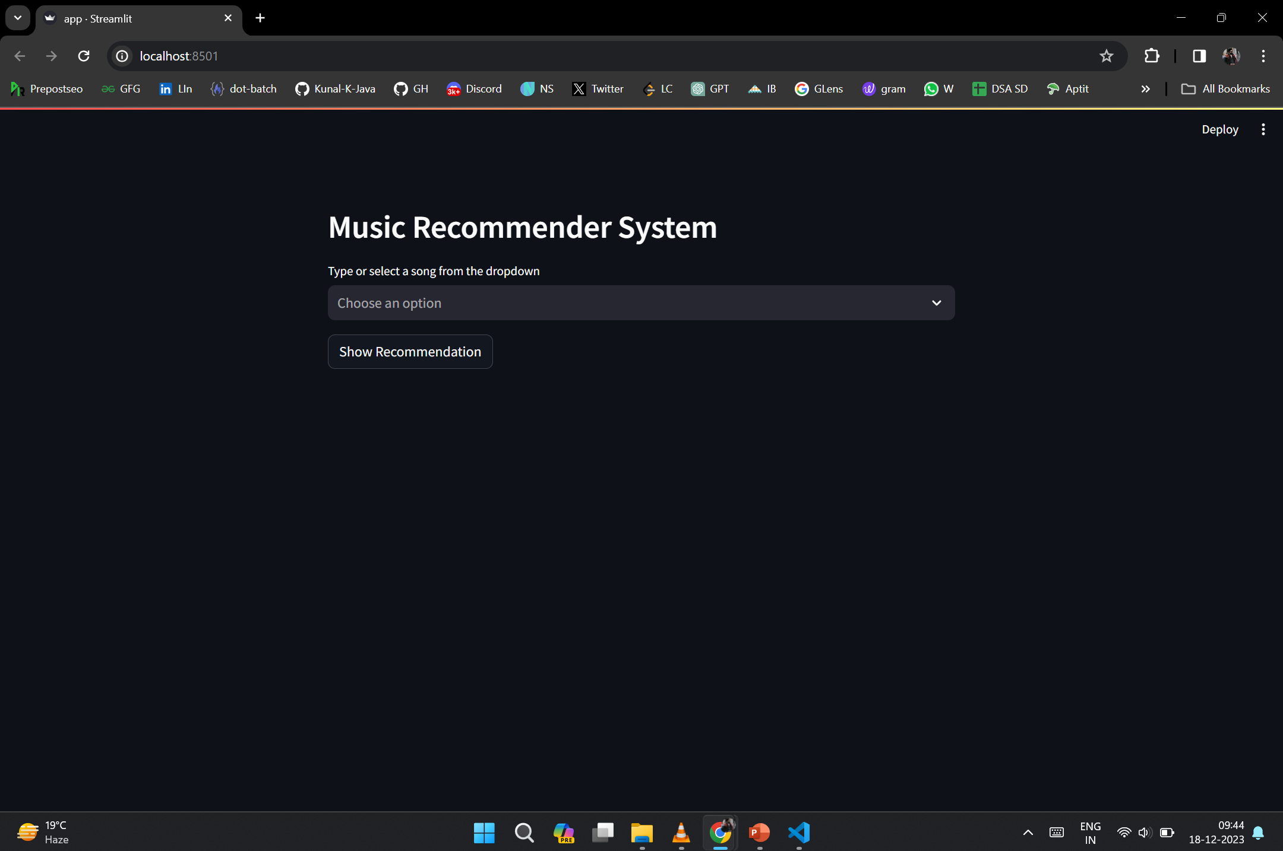
Ui Design of Projects

Slide 9
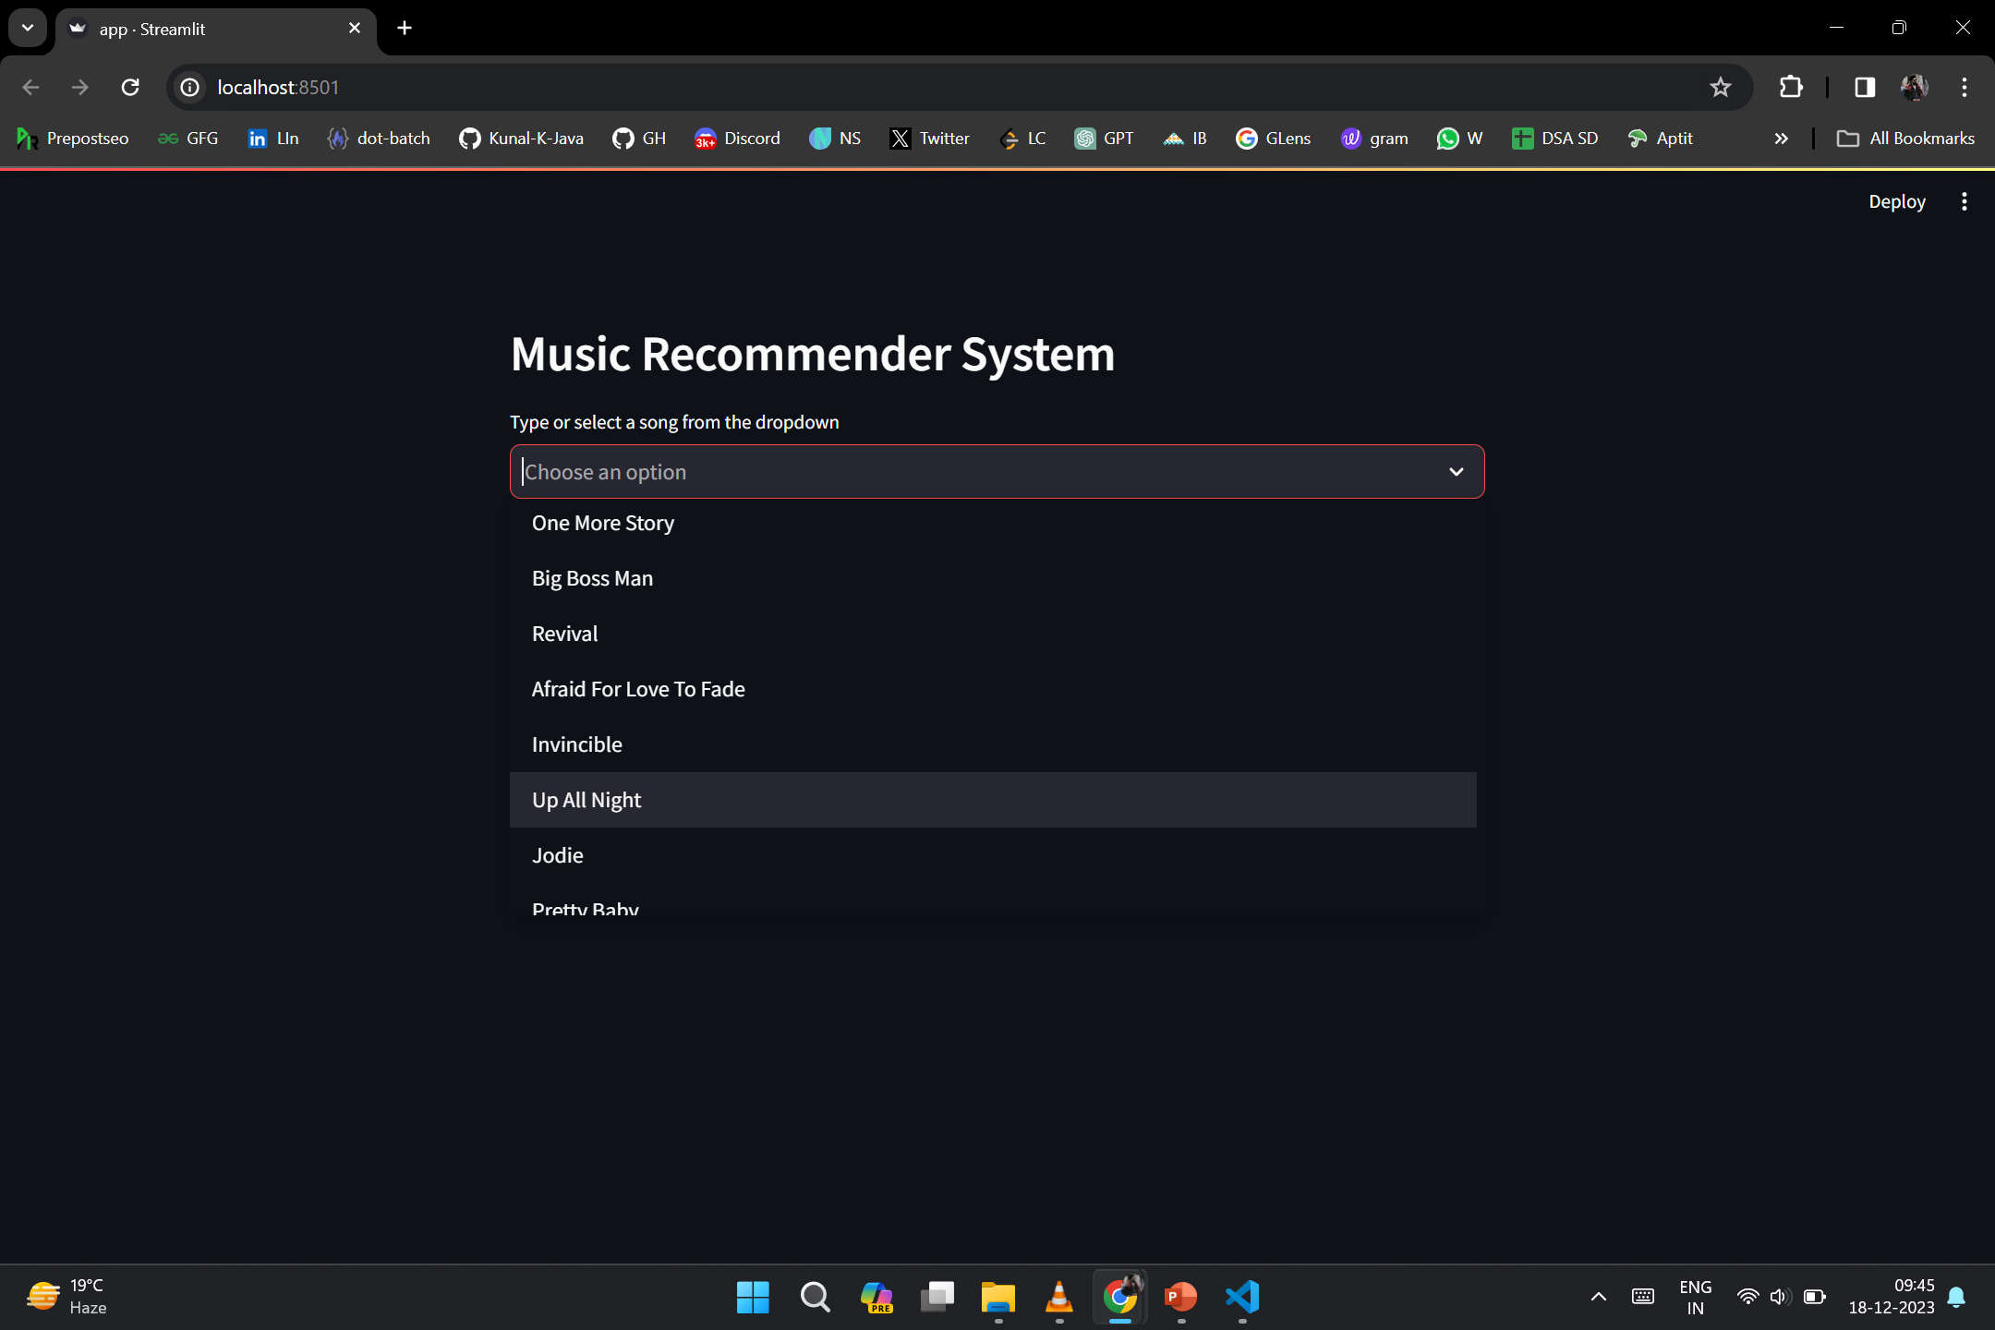

Slide 11
THANK YOU

